Slide 1

CSS Workshop
Presented by { Ryan Samarakoon }

Slide 2

Basics of CSS
CSS Libraries
Bootstrap Basics
Learn more

Slide 3


Who am I?
Hi! I’m Ryan Samarakoon
Working as a professional website developer for 2 years
Currently work as a full-stack developer at Ovio.org and 50raw.com.au
Love dogs, photography, and music
Check out my site! www.ryan-s.me

Slide 4




CSS is a declarative styling language
You declare the styles of any objects you wish and the browser applies these styles to elements you specify
What is CSS and why use it?
CSS is broken into selectors and rules
CSS abstracts away the styling of elements from an imperative style (defining the style for every element individually)

Slide 5

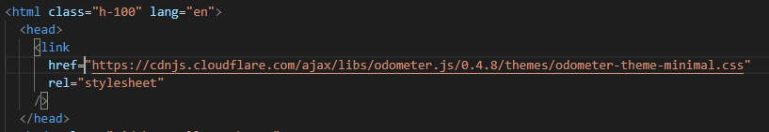
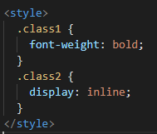
Specify a file/url to import from
How to import CSS into HTML
(the second option is often used by compilers but is not recommended for developers. Remember, the goal of CSS is to abstract styling away from the HTML!)
Chuck your styles right into the HTML

Slide 6
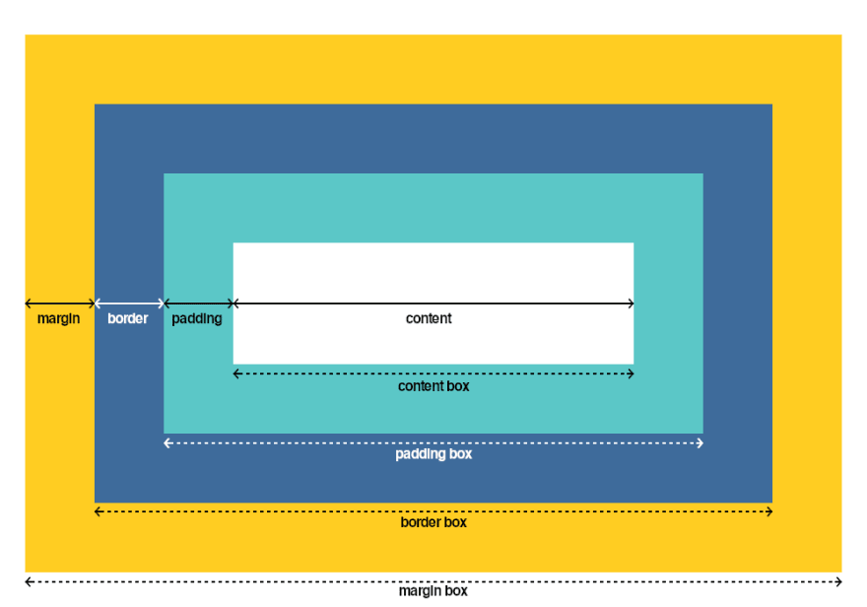
display: (inline, block, flex, grid etc)
margin (px, %, em, rem)
padding (px, %, em, rem)
position (fixed, absolute, relative)
border: (size)px (type: dotted, solid) (colour)HEX
width/height: (length)px, %, vw, vh
We can explore how these properties work on W3
Key Properties
Image source: https://dev.to/alvaromontoro/the-css-box-model-4i32
Explore how elements have a padding, margin and border through dev tools.

Slide 7
text-align (center, left, right)
text-decoration (underline, through)
font-weight: bold, bolder, light
font-family: (order fonts with commas, from highest priority to least)
If the font you wish isn’t found, the next one is used.
E.g: RareFont, Impact, sans-serif (sans is everywhere)
color (#HEX, white, red, blue, etc)
font-size (px, em, rem, %)
It’s recommended to use em and rem for text related properties, and px/% for anything else
em is the ratio font size to the parent, rem is the global ratio font size
border-radius (px, %) (apply to give rounded corners)
box-shadow (x)px (y)px (blur)px (spread)px (colour)HEX
transition (property e.g padding) (time)sec
Easily animate transitions between elements!
background: (image url, colour)
You could also have gradients in your background!
Key properties
(text and misc)
To explore more properties and what they do, check out: https://htmlcheatsheet.com/css/

Slide 8
span {
…
}
The span here is the selector, and determines what element styles are applied to.
Selectors:
* All elements
div all div tags (could be div, p, span or any tag you want)
#id tag with the given id
.class tags with the given class
div p select all p tags which are children of div (including nested)
.class, #id, div combine selectors with commas to select all of them at once
div > p select all p tags which are direct children of div (not nested)
Selectors
Selectors help us select exactly which element we want to style

Slide 9


To select a link which is hovered:
a:hover { … }
To select radio buttons:
input[type=“radio”] { … }
To add a decorator element before or after an element, use:
p::before { … }
p::after { … }
Using before and after can allow you to add cool decorators to your elements, such as:
Selectors (special)
Some selectors allow you to select an element based off its state (whether a button is hovered) or even add elements to the DOM.

Slide 10

When making websites, one size doesn’t fit all
Screens come in all shapes and sizes, How can CSS help make sure our website looks great on all of them?

Slide 11
@media only screen and (max-width: 400px) {
/* You can define your styles in here */ .heading { color: red; } }
This style states that the styles inside will only be active if the width is less than 400px (max width 400px)
You could also do min-width and the opposite would happen (styles are only active if the screen width is larger than 400px)
You can specify a specific range of widths as follows:
@media screen and (max-width: 900px) and (min-width: 600px)
Media Queries
Media queries allow us to activate styles only when the display is a certain size. This is very useful to ensure things don’t look incorrect on mobile.
Read more: https://www.w3schools.com/cssref/css3_pr_mediaquery.asp

Slide 12
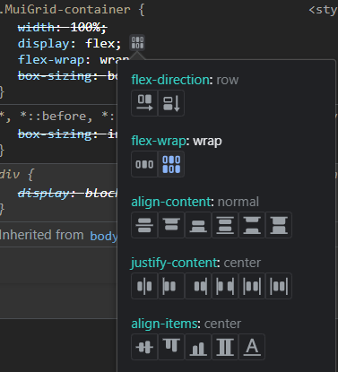
Responsive layout with flexbox
Set display to display: flex
If your items should be arranged vertically, use flex-direction: vertical. Otherwise, leave as is.
Use justify-content and align-items to align your elements horizontally and vertically.
Use flex-wrap if needed to ensure your elements fit on mobile screens.
When developing websites, it is important to ensure your site looks great on desktop and mobile.
Flexbox helps us achieve this as it provides an auto-layout tool to arrange our elements so they all fit
You should be using flexbox the majority of the time when working with lists, rows, or any layout really!
(this helpful UI is present on all Chromium browsers to help you set up your flexbox with a few button clicks)

Slide 13



Bootstrap
One of the most mature CSS frameworks
Provides a base template for buttons, lists, grids etc making layouts super easy from the get-go
Has hundreds of utility classes, making it unlikely you even need to write CSS half the time.
CSS Libraries
You’ve covered the basics, it’s time to see what the open source community has to offer to make CSS easier.
Material UI
An incredibly powerful all-in-one package for UI development
Based off Google’s Material design standard (looks a lot like Google’s UI)
React powered, with CSS-in-JS (a way to embed CSS into your JS files)
SCSS (Sass)
Gives CSS features most programming languages have such as methods (mixins) and ‘if’ statements. Also allows you to nest queries!

Slide 14
As a developer, it’s important to use the documentation given to us by the makers of the library, instead of relying on videos or third-party resources.
Let’s explore what Bootstrap recommends and break down what they’re saying:
https://getbootstrap.com/
You’ll need to learn about new phrases here such as
CDN (Content Delivery Network)
jsDelivr (CDN Provider for source files)
Popper.js (A JS library which adds functionality to our CSS, as CSS by itself is limited in terms of interactivity)
Used for responsive tooltips
Installing Bootstrap

Slide 15
These utility classes are very useful, as you can add breakpoints (sm, md, lg, xl) to specify when they activate, instead of using media queries.
Recommended:
margin and padding: https://getbootstrap.com/docs/5.0/utilities/spacing/
Shadows: https://getbootstrap.com/docs/5.0/utilities/shadows/
Sizing: https://getbootstrap.com/docs/5.0/utilities/sizing/
Display: https://getbootstrap.com/docs/5.0/utilities/display/
Flex: https://getbootstrap.com/docs/5.0/utilities/flex/
Don’t forget to check out Bootstrap’s various components:
https://getbootstrap.com/docs/5.0/components/
Example classes: class=
“d-none d-lg-block” hide on screens smaller than md.
“mt-1 px-3” add a margin of 1 and a left-right padding of 3. (1 and 3 are not pixel counts, and are multiplied by a larger constant)
Bootstrap utility classes
Bootstrap has a lot of classes which are very useful for adding quick styles to certain elements instead of using CSS directly.

Slide 16
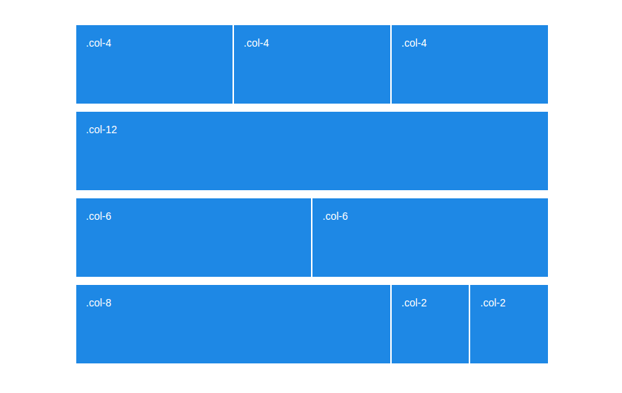
Bootstrap’s Grid
Uses flexbox under the hood, and provides industry-standard responsiveness to any layout you could think of!
Image source: https://www.drupal.org/project/grid_view_bootstrap
Define a container for your grid with a div, with the class container <div class="container">
Define a row within the container with class “row“
Within that row, add as many columns as you wish with class “col“
Repeat until you have all columns and rows you need.
You can make some columns bigger than others by using “col-1“ to “col-12“. The grid consists of 12 columns, and you can split them amongst your cols as you see fit.
You can also add sm, md, lg, xl to make the elements stack vertically at the specified breakpoint.

Slide 17
Now what?

Slide 18
Look at other people’s sites, and break them!
Hands down the fastest way I learnt. Download templates, press F12, play around with styles, explore what happens 👀
(Show a quick demo on how to use devtools like a pro)
Use Codepen!
People are so damn smart on this site 🧠
Search “CSS only” to blow your mind
Look at their projects, and explore what makes them tick
Great way to find things to add to your own sites
Watch Youtube!
There are some awesome CSS creators on this site
People I watch: Kevin Powell, DevEd, Web Dev Simplified
Use W3!
Their interactive demos and tables are a godsend. Very quick to read and play around with. Instantly learn new rules quickly
(If you want to become a GOD) CSS Battles!
Challenge a friend on this site and use CSS to make the closest matching design to a given image ⚔
Not easy. If you want to see what it’s about, watch a battle YouTube.
The learning doesn’t stop here
Here are some resources I found very helpful on my journey as a web developer.

Slide 19
CSS Variables
Quite a recent feature, only widespread in 2016
Allows you to save colours, fonts, settings etc in variables to use repeatedly.
Very useful to help you stick to a constant palette when making websites
This feature is also provided in SCSS if the native implementation is too confusing
CSS Animations
Make your websites pop with animation, transition and @keyframe tags!
CSS Grid
A more advanced version of flexbox for really intricate layouts
Has extra features such as column/row gaps, pixel-perfect column sizes, etc
A lot more powerful than flexbox, however has a larger learning curve
caniuse: caniuse.com
Every good web developer ensures that the CSS properties they use are supported by the browsers they’re targeting.
Consider using this site as you enter the industry
We only scratched the surface...
Try looking up these terms and learn more advanced CSS techniques!

Slide 20

Thank you!
What’s next?
Make sure to come to our next workshop: Computer Vision will be happening tonight @ 4PM
Find today’s workshop resources, powerpoint and video recording in the Participant’s handbook (Resources -> Workshops -> Specific workshop )
Make sure you join the Melbourne Hackathon 2021 discord for more updates!
Please fill out our feedback form: https://forms.gle/WsoaCuswy3qdBE3fA

